Slide 1
Boolean Algebra & Logic Gates
Chapter 2D
Imran Siddiqi
imran.siddiqi@mcs.edu.pk
Computer Science Department
College of Telecommunication Engineering
National University of Sciences and Technology

Slide 2
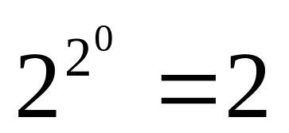
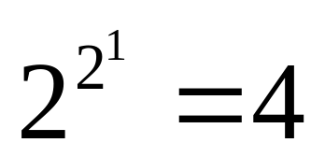
Functions
For 0 variables there exist how many functions?
For 1 variable a there exist how many functions?
  f0 = 0; f1 = 1
  f0 = 0; f1 = a;
  f2 = ā; f3 = 1;

Slide 3
Truth Table for 1 variable
Truth tables of the 4 functions for n = 1
a | f(a) = 0
0 | 0
1 | 0
a | f(a) = a
0 | 0
1 | 1
a | f(a) = ā
0 | 1
1 | 0
a | f(a) = 1
0 | 1
1 | 1

Slide 4
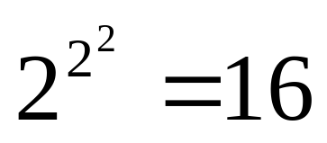
Truth Table for 2 variables
One can have 16 functions of two variables
f₀ to f₁₅
x | y | f0 | f1 | f2 | f3 | f4 | f5 | f6 | f7 | f8 | f9 | f10 | f11 | f12 | f13 | f14 | f15
0 | 0 | 0 | 0 | 0 | 0 | 0 | 0 | 0 | 0 | 1 | 1 | 1 | 1 | 1 | 1 | 1 | 1
0 | 1 | 0 | 0 | 0 | 0 | 1 | 1 | 1 | 1 | 0 | 0 | 0 | 0 | 1 | 1 | 1 | 1
1 | 0 | 0 | 0 | 1 | 1 | 0 | 0 | 1 | 1 | 0 | 0 | 1 | 1 | 0 | 0 | 1 | 1
1 | 1 | 0 | 1 | 0 | 1 | 0 | 1 | 0 | 1 | 0 | 1 | 0 | 1 | 0 | 1 | 0 | 1

Slide 5
Truth Table for 2 variables
x | y | f0 | f1 | f2 | f3 | f4 | f5 | f6 | f7 | f8 | f9 | f10 | f11 | f12 | f13 | f14 | f15
0 | 0 | 0 | 0 | 0 | 0 | 0 | 0 | 0 | 0 | 1 | 1 | 1 | 1 | 1 | 1 | 1 | 1
0 | 1 | 0 | 0 | 0 | 0 | 1 | 1 | 1 | 1 | 0 | 0 | 0 | 0 | 1 | 1 | 1 | 1
1 | 0 | 0 | 0 | 1 | 1 | 0 | 0 | 1 | 1 | 0 | 0 | 1 | 1 | 0 | 0 | 1 | 1
1 | 1 | 0 | 1 | 0 | 1 | 0 | 1 | 0 | 1 | 0 | 1 | 0 | 1 | 0 | 1 | 0 | 1
x.y
x
y
x+y
xy + x’y’
x+y’
x’+ y
1
0
x.y’
x’.y
xy’+x’y
(x+y)’
y’
x’
(xy)’

Slide 6
F0=0 Constant 0 or Null
F1= x.y➔ AND (x and y)
F2 = xy’➔ x but not y
F3 = x
F4 = x’y➔ y but not x
F5 = y
F6 = xy’ + x’y ➔Exclusive OR ( x or y but not both)
F7= x+y ➔OR (x or y)
F8 = (x+y)’ ➔ NOR (Not OR)
F9 = xy + x’y’➔ Equivalence (x equals y)
F10 = y’ ➔Not y
F11 = x+y’➔ If y then x
F12 = x’ (Not x)
F13 = x’ + y If x then y
F14 = (xy)’ ➔ NAND
F15 = 1 Binary constant 1

Slide 7
F0=0 Constant 0 or Null
F1= x.y➔ AND (x and y)
F2 = xy’➔ x but not y
F3 = x
F4 = x’y➔ y but not x
F5 = y
F6 = xy’ + x’y ➔Exclusive OR ( x or y but not both)
F7= x+y ➔OR (x or y)
F8 = (x+y)’ ➔ NOR (Not OR)
F9 = xy + x’y’➔ Equivalence (x equals y)
F10 = y’ ➔Not y
F11 = x+y’➔ If y then x
F12 = x’ (Not x)
F13 = x’ + y If x then y
F14 = (xy)’ ➔ NAND
F15 = 1 Binary constant 1

Slide 8
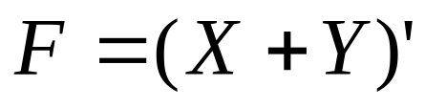
NOR Gate
2-input NOR logic gate:
X | Y |  | F
0 | 0 |  | 1
0 | 1 |  | 0
1 | 0 |  | 0
1 | 1 |  | 0
x
F
y

Slide 9
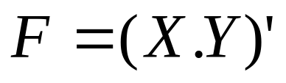
NAND Gate
2-input NAND logic gate:
X | Y |  | F
0 | 0 |  | 1
0 | 1 |  | 1
1 | 0 |  | 1
1 | 1 |  | 0
x
F
y

Slide 10

Exclusive OR Gate
2-input exclusive-OR (XOR) logic gate:
X | Y |  | F
0 | 0 |  | 0
0 | 1 |  | 1
1 | 0 |  | 1
1 | 1 |  | 0
x
F
y

Slide 11
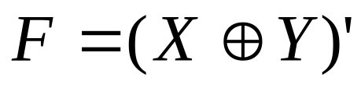
Exclusive NOR Gate
2-input exclusive-NOR logic gate:
X | Y |  | F
0 | 0 |  | 1
0 | 1 |  | 0
1 | 0 |  | 0
1 | 1 |  | 1
x
F
y

Slide 12
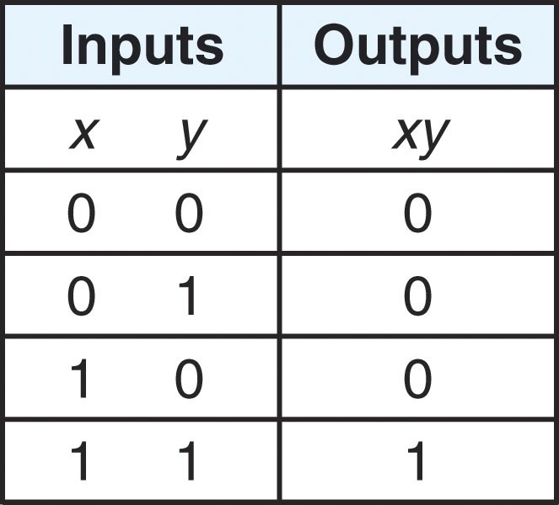
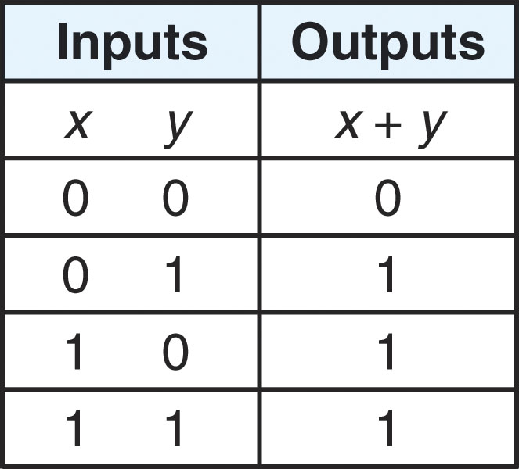
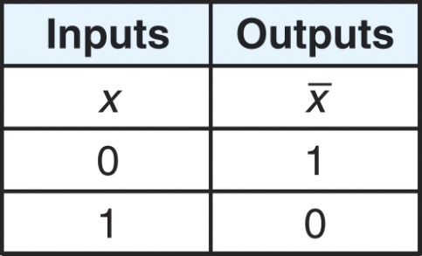
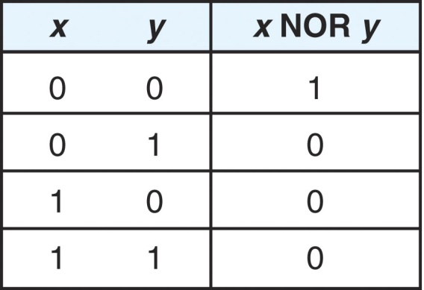
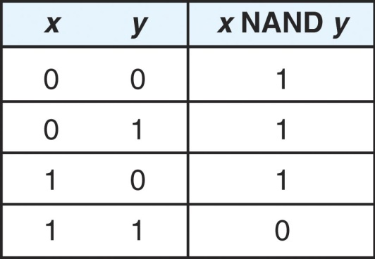
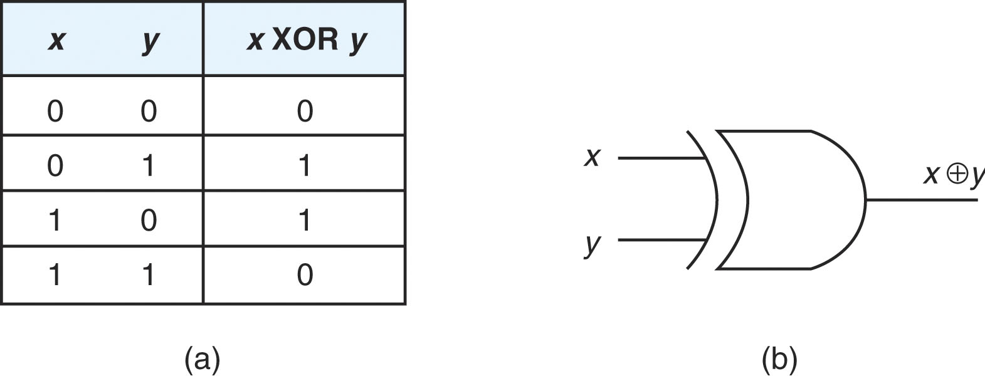
Summary
xy = x AND y = x * y x + y = x OR y x bar = NOT x
AND is true only if OR is true if either NOT inverts the bit
both inputs are true inputs are true We will denote x bar as ~X
NOR is NOT of OR NAND is NOT of AND XOR is true if both inputs
differ

Slide 13
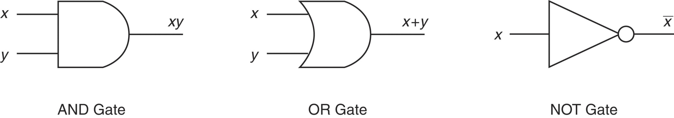


Summary
Here we see the logic gates
that represent the boolean
operations previously
discussed
XOR looks like OR
but with the added
curved line
We typically represent NOR and NAND by the two
on the left, but the two on the right are also correct

Slide 14
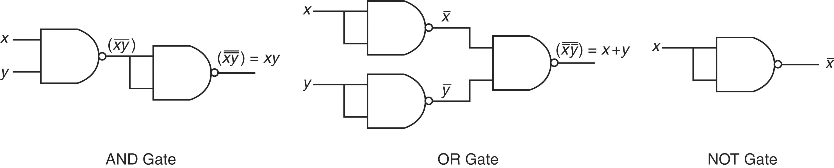
Using only NAND
NAND (and NOR) gates are called Universal Gates
Using NAND gates (or NOR gates) we can create circuits that compute AND, OR and NOT

Slide 15
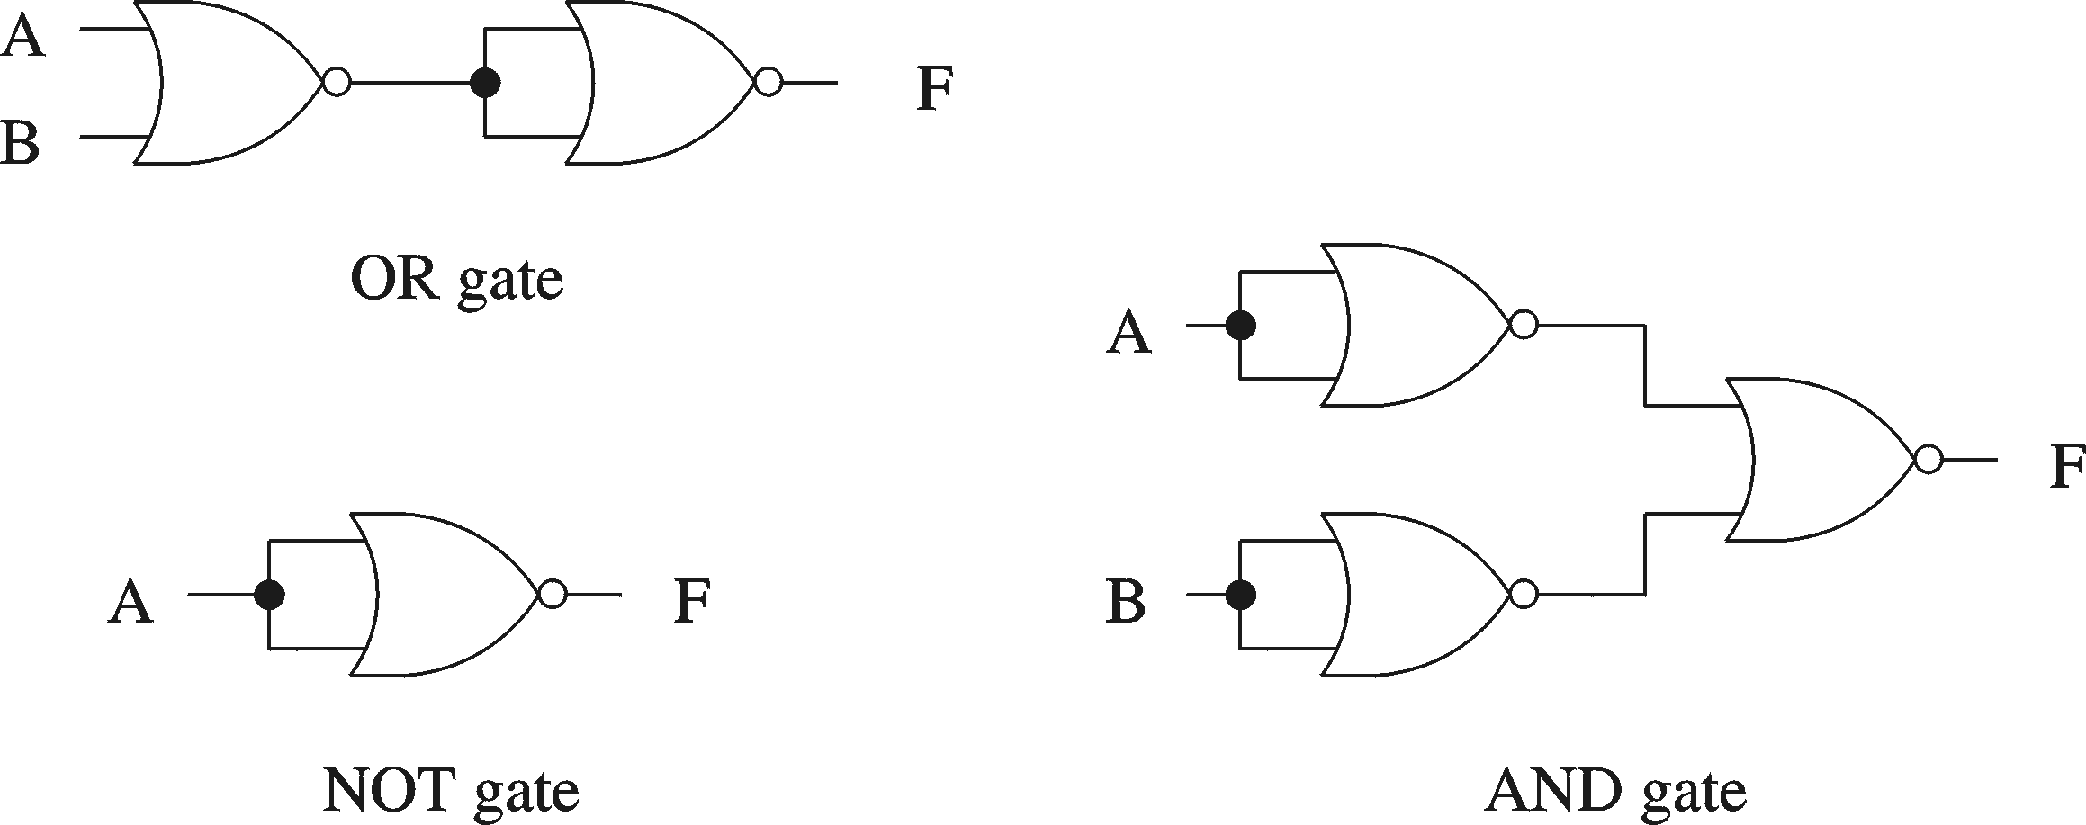
Using only NOR

Slide 16

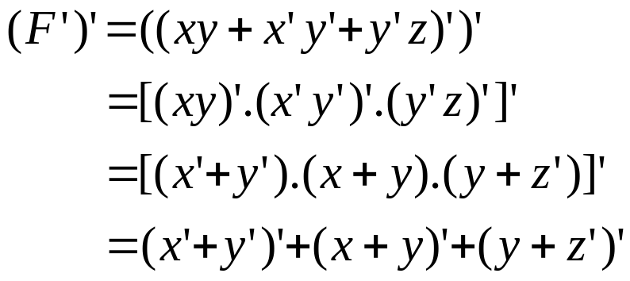
I
Implementation of functions
  Using only OR and NOT gates, draw a schematic for the
  following function:
x
y
F
z

Slide 17
Implementation of functions
  Using ONLY NAND gates, draw a schematic for the following
  function: F = (a.b)+(b.c)
a
b
F
c

Slide 18

Multiple Input Gates
3-input exclusive-OR (XOR) logic gate:
X | Y | Z | F
0 | 0 | 0 | 0
0 | 0 | 1 | 1
0 | 1 | 0 | 1
0 | 1 | 1 | 0
1 | 0 | 0 | 1
1 | 0 | 1 | 0
1 | 1 | 0 | 0
1 | 1 | 1 | 1
x
y
F
z
Implemented by 3 Input Gates
x
y
F
z
Implemented by 2 Input Gates

Slide 19
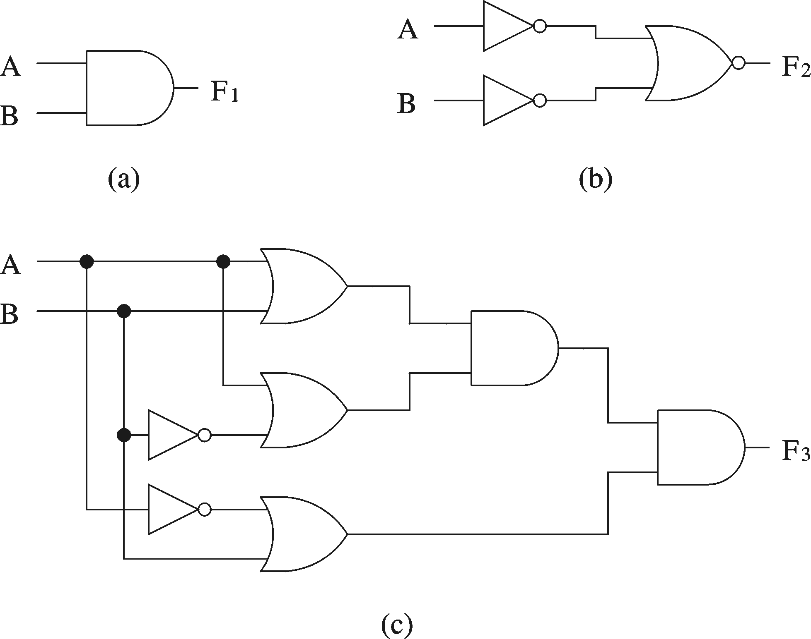
Logical Equivalence
All three circuits implement F = A B function

Slide 20
Logical Equivalence
Proving logical equivalence of two circuits
  Derive the logical expression for the output of each circuit
  Show that these two expressions are equivalent
Two ways:
  You can use the truth table method
  You can also use algebraic manipulation

Slide 21
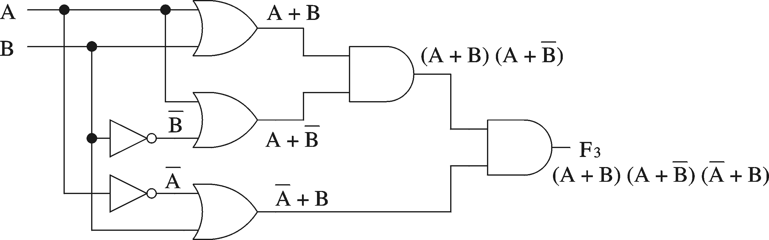
Logical Equivalence
Derivation of logical expression from a circuit
  Trace from the input to output
  Write down intermediate logical expressions along the path

Slide 22
Logical Equivalence
Proving logical equivalence: Truth table method
  A B F1 = A B F3 = (A + B) (A + B) (A + B)
  0 0 0 0
  0 1 0 0
  1 0 0 0
  1 1 1 1

Slide 23
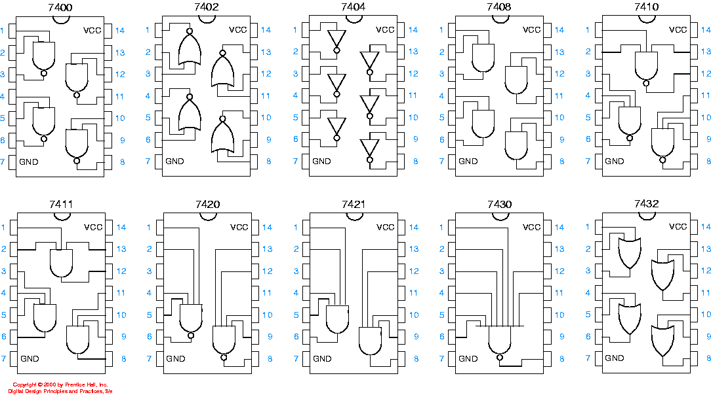
Logic Chips

Slide 24
Logic Chips
Digital Electronics devices are usually in a chip format.
The chip is identified with a part number or a model number.
A standard series starts with numbers 74, 4, or 14.
  7404 is an inverter
  7408 is an AND
  7432 is an OR
  4011B is a NAND

Slide 25
Logic Chips
Actual circuit is on a small chip of silicon
1
14
HD74LS04P
2
13
3
12
Pins are connected to chip with internal wires
HD74LS04P
11
4
5
10
Package – Made of plastic or ceramic
6
9
7
8
Pin number one is identified with a dot or notch
Pins are numbered in a counter-clockwise fashion

Slide 26
Logic Chips: Examples
1
Vcc
14
1
Vcc
14
2
13
2
13
3
12
3
12
74LS02
11
74LS04
4
4
11
5
10
5
10
6
9
6
9
7
GND
8
7
GND
8
NOR
Inverter

Slide 27
Logic Chips: Examples
NAND Gates
1
Vcc
14
2
13
3
12
4
74LS00
11
5
10
6
9
7
GND
8

Slide 28
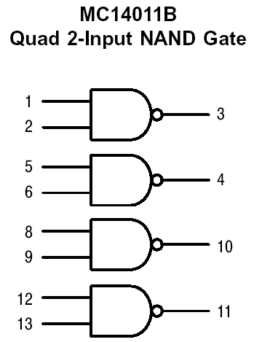
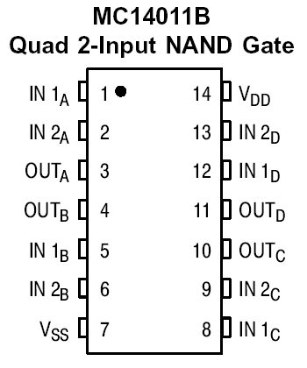
Logic Chips
A
B
C
D

Slide 29
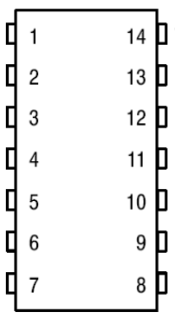
Logic Chips
IN
Vcc
IN
OUT
Vcc

Slide 30
Logic Chips – Integration Levels
SSI (small scale integration)
  Introduced in late 1960s
  1-10 gates (previous examples)
MSI (medium scale integration)
  Introduced in late 1960s
  10-100 gates
LSI (large scale integration)
  Introduced in early 1970s
  100-10,000 gates
VLSI (very large scale integration)
  Introduced in late 1970s
  More than 10,000 gates

Slide 31
Digital Logic Families
TTL
  Transistor-Transistor Logic
ECL
  Emitter Coupled Logic
MOS
  Metal Oxide Semi Conductor
CMOS
  Complementary Metal Oxide Semi Conductor

Slide 32

Fan-In
Fan in of a gate is the number of inputs to the gate
A 3-input OR gate has a fan-in = 3
Fanin = 4
Fanin = 1
Fanin = ?

Slide 33
Fan-Out
Fan out of a gate is the number of gates that it can drive
The driven gate is called a load
driving gate
(driver)
load gates
(load)
Fanout = 3

Slide 34
References
Chapter 2 – Digital Design Morris Mano
Digital Logic Circuits – V.D. Agrawal, Auburn University, Auburn
Logic System Design – Seattle Pacific University
Material in these slides has been taken from, the following resources

